Slide 1

Algorithms and Data Structures 1 CS 0445
Fall 2023
ADT List
Sherif Khattab
ksm73@pitt.edu
(Slides are adapted from Dr. Ramirez’s and Dr. Farnan’s CS1501 slides.)

Slide 2
Announcements
Upcoming Deadlines:
Homework 4: Tuesday 9/26 @ 11:59 pm
Programming Assignment 1: Friday 9/29 @ 11:59 pm
Please make your Piazza posts public as much as possible
Assignment 1 Support today at 6 pm over Zoom
Same link as my virtual office (https://pitt.zoom.us/my/Khattab)
Session will be recorded

Slide 3
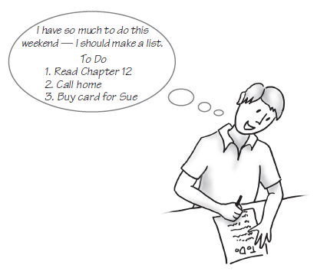
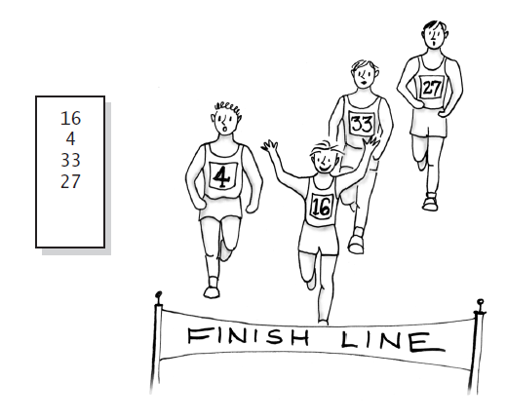
ADT List
Example: a to-do list
Example: a list of numbers that identify runners in the order in which they finished a race

Slide 4
Specifications for the ADT List
add(newEntry)
add(newPosition, newEntry)
remove(givenPosition)
clear()
replace(givenPosition, newEntry)
getEntry(givenPosition)
toArray()
contains(anEntry)
getLength()
isEmpty()

Slide 5
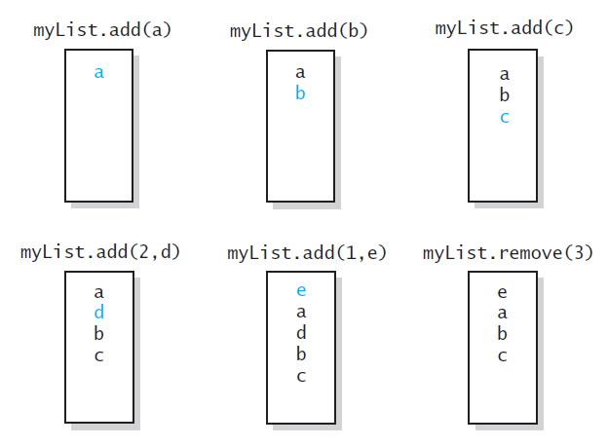
Specifications for the ADT List
The effect of ADT list operations on an initially empty list
List positions start from 1

Slide 6
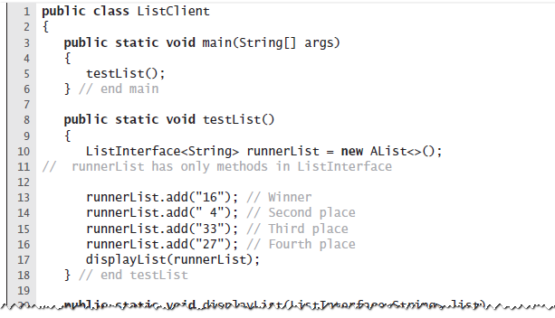
Using the ADT List
A client of a class that implements ListInterface

Slide 7
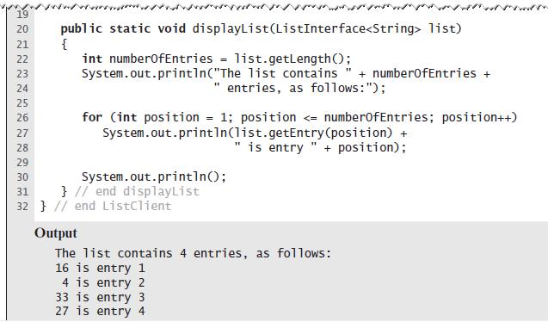
Displaying a List

Slide 8
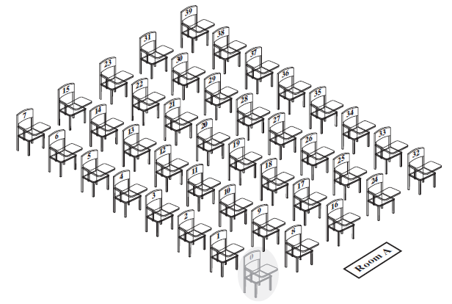
Array to Implement the ADT List
A classroom that contains desks in fixed positions

Slide 9
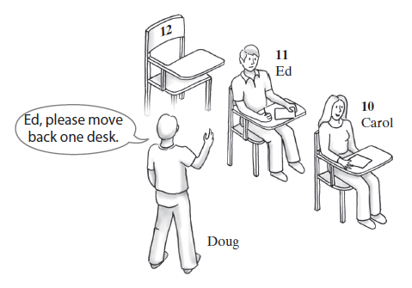
Array to Implement the ADT List
Seating a new student between two existing students: At least one other student must move

Slide 10
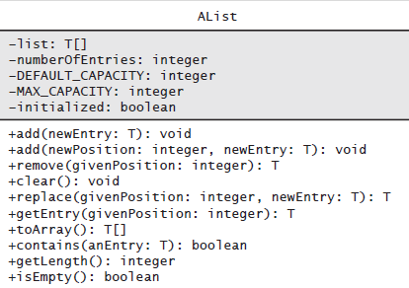
Class AList

Slide 11
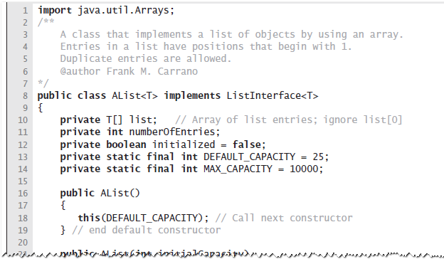
Class AList

Slide 12
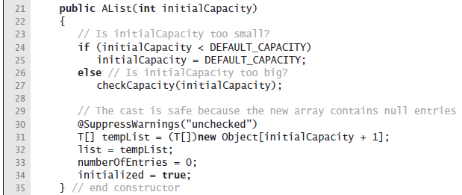
Alist Constructor
List positions start from 1
Put ith item in List at position i in the internal array
array[0] will always be empty → need one extra entry

Slide 13
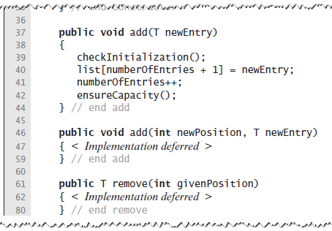
Adding at the end

Slide 14
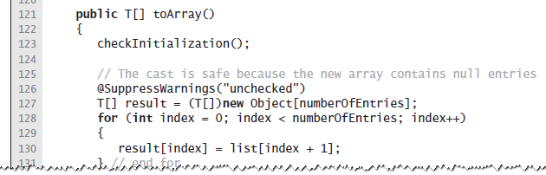
toArray
List positions start from 1
Put ith item in List at position i-1 in the output array

Slide 15
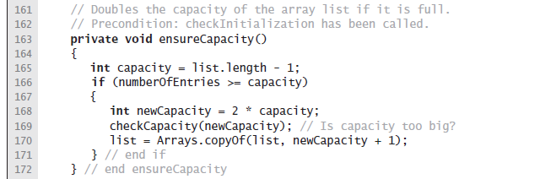
Doubling the capacity if needed

Slide 16
Adding to the middle of AList
add(3, 25)
null
null
null
41
41
20
20
13
2
13
57
2
91
57
26
91
10
26
20
10
0
25
20
0
null
0
0
1
1
2
2
3
3
4
4
5
5
6
6
7
7
8
8
9
9
10
11
10

Slide 17
How to make room for an entry at newPosition
index
index
index
index
null
41
20
13
2
57
91
26
10
20
0
null
null
13
2
57
91
26
10
20
0
0
1
2
3
4
5
6
7
8
9
10
newPosition
numberOfEntries
for(index = numberOfEntries; index >= newPosition; index--){
list[index + 1] = list[index];

Slide 18
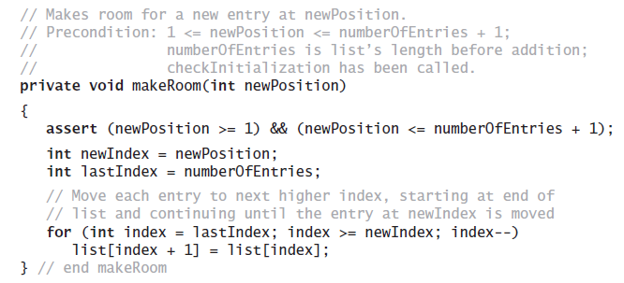
Making room for new entry

Slide 19
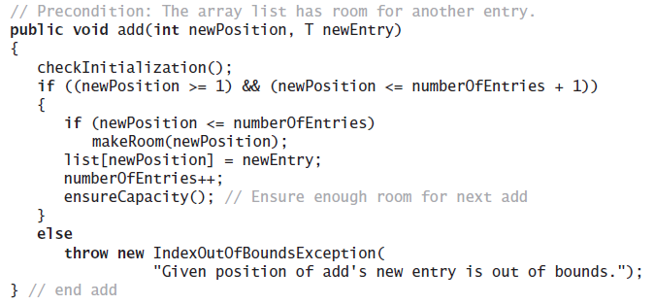
Adding to the middle of AList

Slide 20
Removing from the middle of AList
remove(3)
null
2
57
91
26
10
null
41
41
20
20
13
2
57
91
26
10
20
0
20
0
null
null
null
0
0
1
1
2
2
3
3
4
4
5
5
6
6
7
7
8
8
9
9
10
11
12
10

Slide 21
How to fill gap at givenPosition
index
index
index
index
null
41
20
13
2
57
91
26
10
20
0
null
null
2
57
91
26
10
20
0
0
1
2
3
4
5
6
7
8
9
10
givenPosition
numberOfEntries
for(index = givenPosition; index < numberOfEntries; index++){
list[index] = list[index + 1];

Slide 22
Adding to the middle of AList

Slide 23
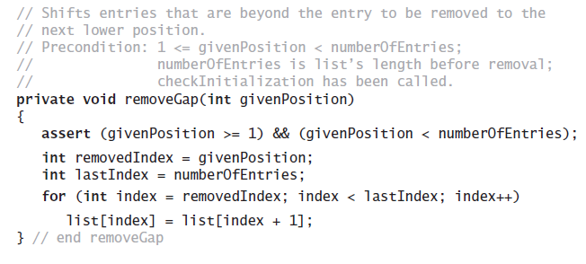
Method removeGap shifts list entries within the array

Slide 24
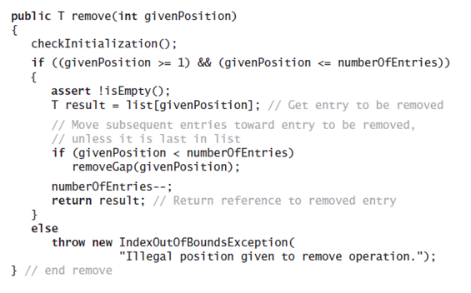
remove

Slide 25
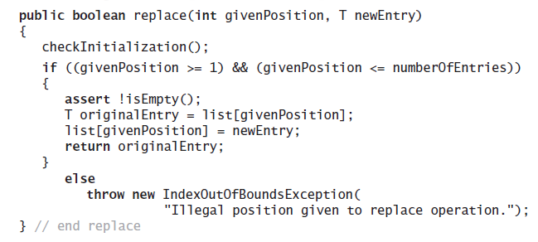
Replacing an entry

Slide 26
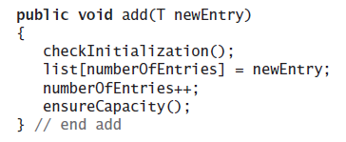
Runtime of appending
Operation that adds a new entry to the end of a list
Efficiency O(1) if new if array is not resized.

Slide 27
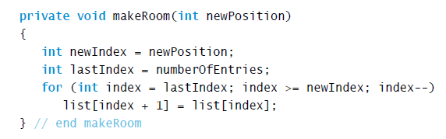
Runtime of makeRoom
Runtime depends on numberOfEntries (array size) and on client-specified position
What is the worst-case?
newPosition == 1
for loop goes from n down to 1
n iterations with constant time per iteration (why?)
O(n)

Slide 28
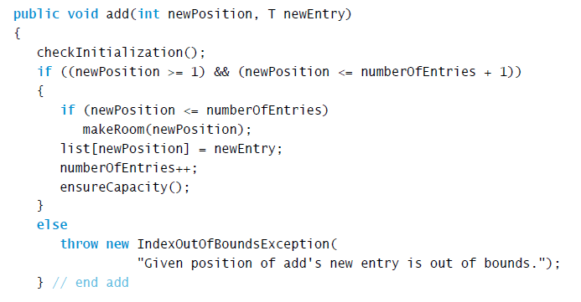
Runtime of general add
add calls makeRoom
Worst-case runtime of add is O(n)

Slide 29
Linked Implementation (LList)
Uses memory only as needed
When entry removed, unneeded memory returned to system
Avoids moving data when adding or removing entries

Slide 30
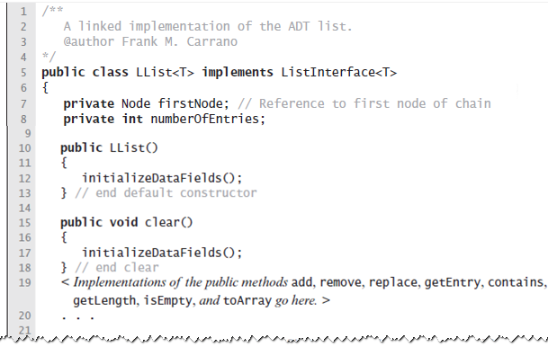
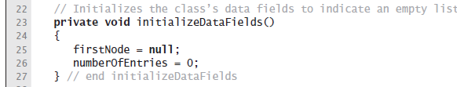
Data Fields and Constructor

Slide 31
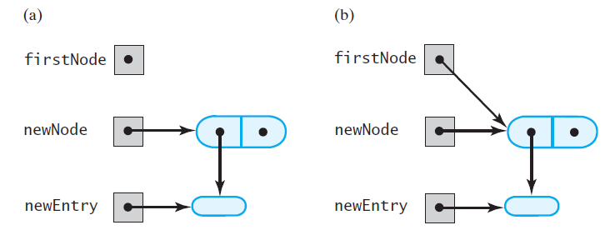
Adding a Node to an empty chain
after adding the new node to a chain that was empty
an empty chain and a new node

Slide 32
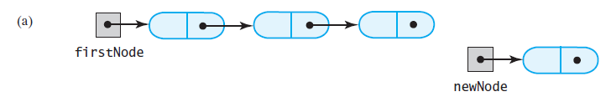
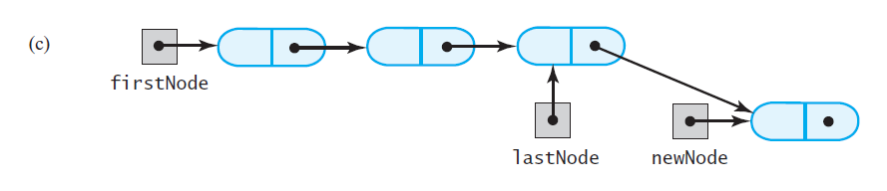
Adding a Node at the end of the chain
A chain of nodes prior to and after adding a node at the end

Slide 33
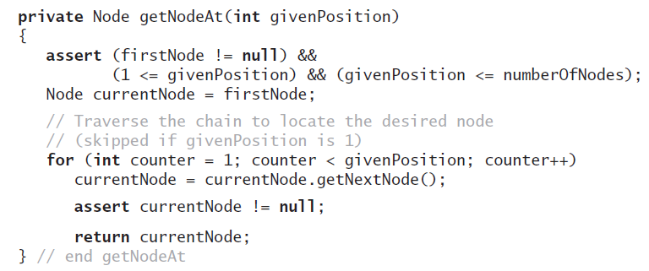
How to get a reference to the last node?

Slide 34
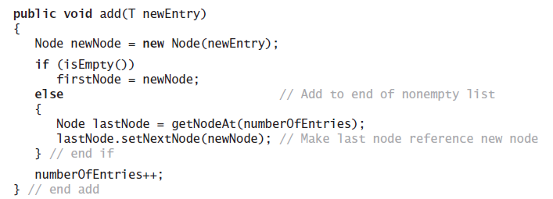
Adding to the End of the List

Slide 35
Adding a Node at client-specified position
Possible cases:
Adding node at chain’s beginning
Adding node between adjacent nodes
Adding node to the end of the chain

Slide 36
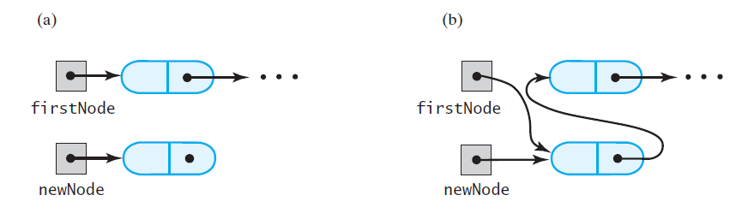
Adding a Node at the beginning of the chain
prior to adding a node at the beginning
after adding a node at the beginning

Slide 37
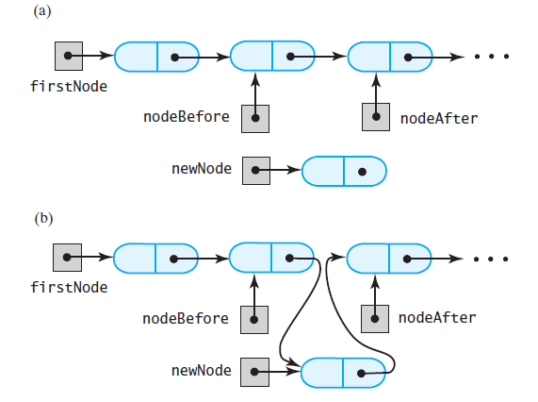
Adding a Node in the middle of the chain
prior to adding a node between two adjacent nodes
after adding a node between two adjacent nodes

Slide 38
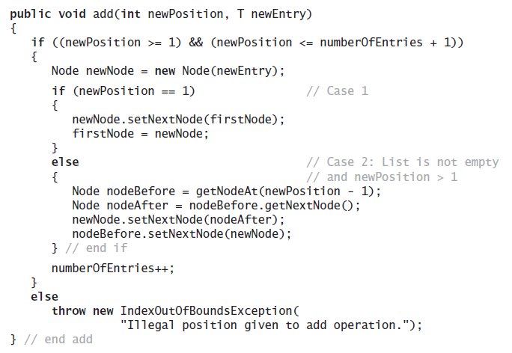
Adding at a Given Position

Slide 39
Removing a Node at a given position
Possible cases:
Removing from an empty chain
IndexOutOfBounds exception
Removing the first node
Removing the last node
Removing a node other than first and last

Slide 40
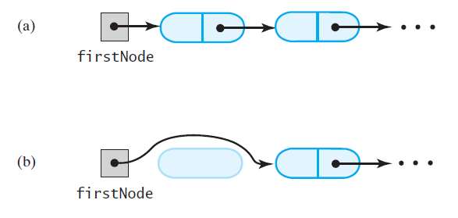
Removing the first node
prior to removing the first node
after removing the first node

Slide 41
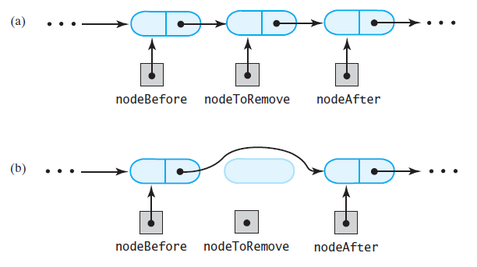
Removing a Node other than first node
prior to removing an interior node
after removing an interior node

Slide 42
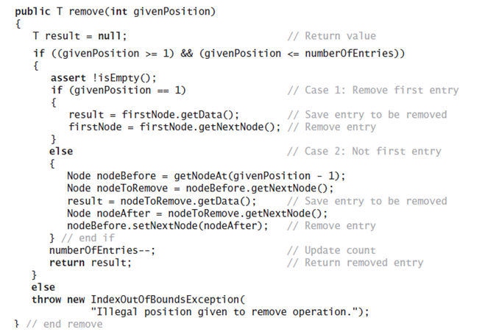
The remove method

Slide 43
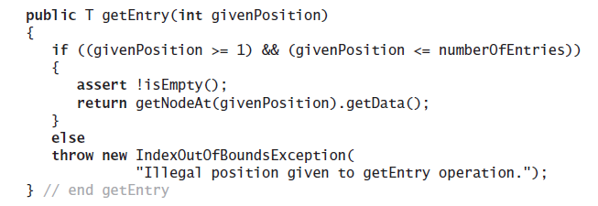
getEntry

